Slide 1
Illegal, Unregulated & Unreported Seafood (EC n° 1005/2008 & 1010/2009 + amendments): The view from the Importer
Olivier Hottlet
Hottlet Frozen Foods

Slide 2
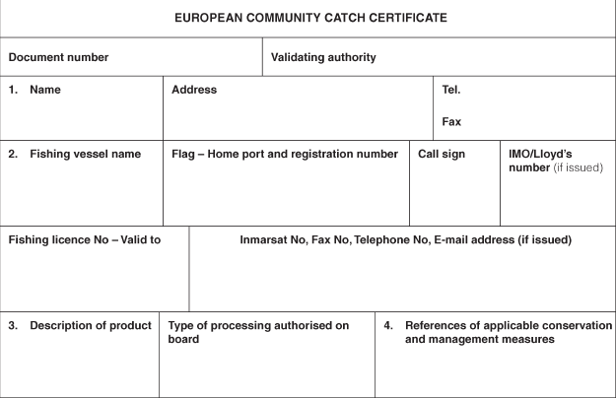
Annex II of IUU 1005/2008: Catch certificate model

Slide 3
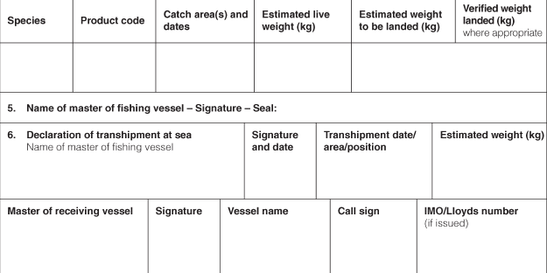
Annex II of IUU 1005/2008: Catch certificate model

Slide 4
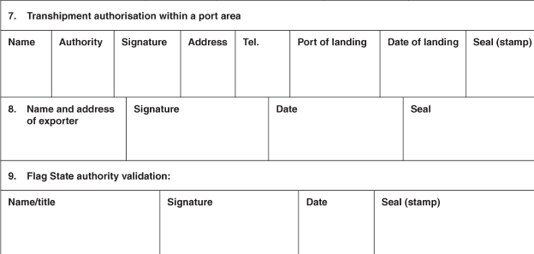
Annex II of IUU 1005/2008: Catch certificate model

Slide 5
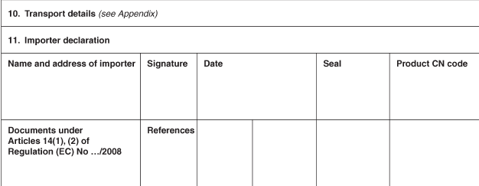
Annex II of IUU 1005/2008: Catch certificate model

Slide 6
Annex II of IUU 1005/2008: Catch certificate model

Slide 7
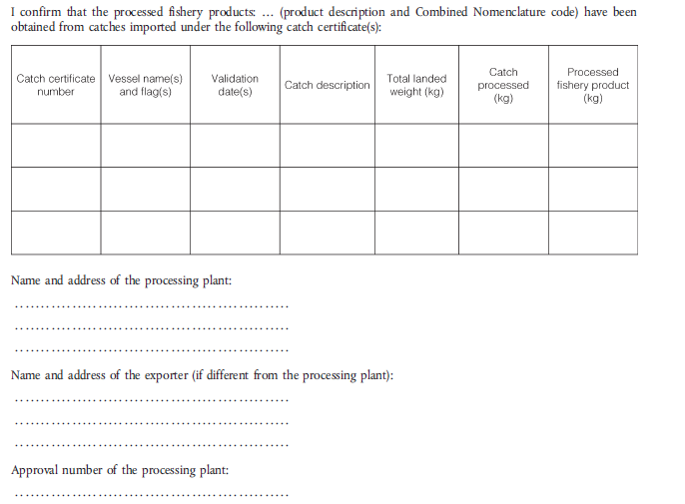
Annex IV of IUU 1005/2008: Processing statement (imported raw material)

Slide 8
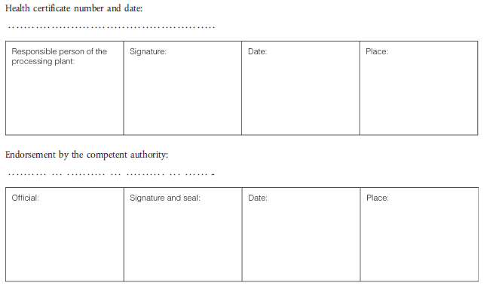
Annex IV of IUU 1005/2008: Processing statement (imported raw material)

Slide 9
Additional info on products processed in the Flag State to be exported to EU
Published: 24 May 2011
Concerns fishery products processed in the flag State of the catching vessel to be exported to EU.
When fishery products are caught and processed in the same flag State, the validation of the catch certificate for the purpose of the IUU Regulation should only occur at the moment when the final product is ready to be exported to the EU.
In this situation, the IUU Regulation does not provide for the use of an annex equivalent to Annex IV for imported fish products. Only a catch certificate is required for the consignment to be exported.

Slide 10
Additional info on products processed in the Flag State to be exported to EU
In order to ensure full traceability, certain third countries have found it necessary to implement internal procedures and controls in the validation process of the catch certificate for domestically processed products. In this respect they will provide information on vessels, masters and product description (including additional information on the processing flows) as an attachment to the catch certificate.
Colombia, Ecuador, Uruguay and Vietnam have notified the EC that they will provide such additional information. Other third countries interested in providing this detailed information are invited to discuss this issue bilaterally with the EC before implementing it. In these discussions, the EC will explain the use of this document in connection with the catch certificate and the existing third country control procedures.

Slide 11
Additional info on products processed in the Flag State to be exported to EU

Slide 12
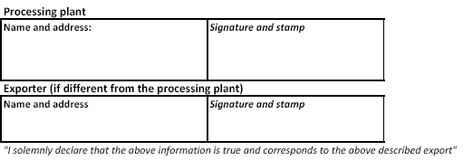
Additional info on products processed in the Flag State to be exported to EU

