Slide 1

Hygiene and Inspection
The European Position
2011 World Seafood Congress
C.P.Leftwich
Chief Inspector
Fishmongers’ Company, London
Sponsors

Slide 2

Import Procedure
Border Controls – Third Country Imports
Directive 97/78 establishes the veterinary checks system
Sets principles for inspection of imported animal products at point of entry to Community territory
Implemented in all Member States
Details of inspections, procedures, inspection facilities laid down in subordinate Community Legislation…

Slide 3
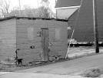

Inspection Facilities-
Border Inspection Posts – over 300 BIP’s in the EU
2001/812 BIP Requirements;
  Equipment
  Offices
  Inspection areas
  Staffing
  Documents
  Records
  Procedures
Notes:
Not all BIP’s will be authorised to handle all products. Explain

Slide 4
Inspection of Consignments
Documentary Check
Identity Check
Physical Check
Notes:
All consignments will have a documentary check. Inspection of health certificates and CVED’s
All Consignments will also have an identity check to ensure paperwork correlates to the product
20% of consignments will have a physical check

Slide 5
TRACES
Trade Control and Expert System
RASFF
Rapid Alert System for Food and Feed
Notes:
Traces was introduced in 1994 as a result of the failure of the two previous systems – Replaced Animo (Animal Movement System) and Shift (System to assist with Health controls of Import of items of veterinary concern at Frontier inspection posts from Third countries.
Introduced the CVED – Community Veterinary Entry Document
Allows for tracking of goods and live animals through the system
All languages of the EU and Russian
Comes under the jurisdiction of DG SANCO – Directorate General for Health and Consumer Protection
Linked into RASFF system for notifications across the EU

Slide 6

EC Regulation 178/2002 Article 50
Established the Rapid Alert System
Covers all EU member states plus, Norway, Liechtenstein and Iceland ( members of the European Economic Area –EEA)
Places a duty on all members to notify the commission on
- Any measures restricting food being placed on the market, forcing withdrawal or recall.
-Recommendation or agreements with professional operators either voluntary or obligatory aimed at preventing, limiting or imposing specific conditions on placing of food on the market
-Any rejections at a Border Inspection Post
System operates 7 days a week, 24 hours a day.

Slide 7





4 types of notifications
Action required not rapid due to product not yet reaching the market or is no longer on the market
Serious rapid action required
Something of interest that does not fall into the 3 previous categories
Product refused entry

Slide 8
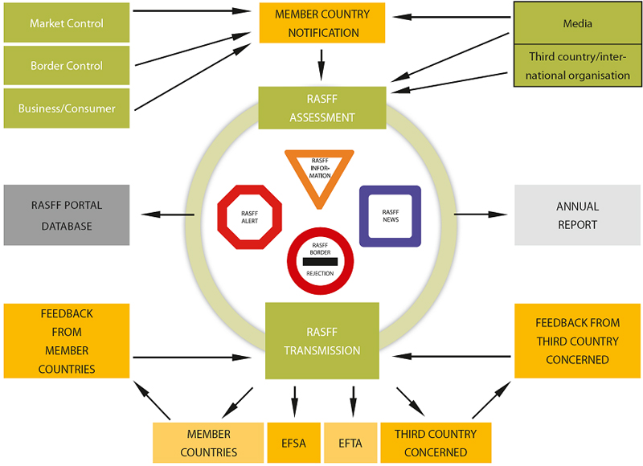
Notes:
EFSA European Food Safety Authority
EFTA European Free Trade Association – EU plus Liechtenstein, Iceland, Norway and Switzerland

Slide 9
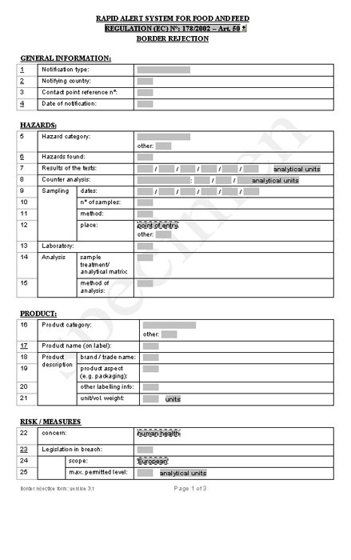

Slide 10
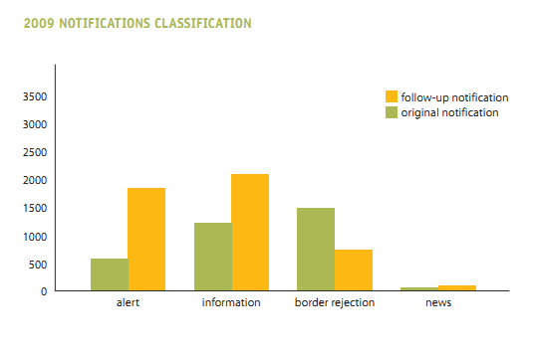

3332 original notifications transmitted
4767 follow up notifications

Slide 11
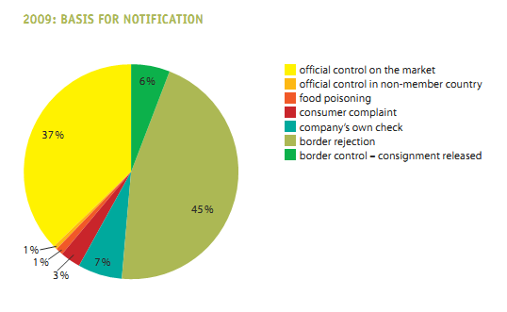

Notes:
By far the largest were border inspection controls
Official controls on the internal market covers things such as consumer complaints, own company checks or food poisoning
In 2009 a new category was identified. Where a non-member Country identifies a risk regarding a product that may be on the market in a member country. If the commission feel there is genuine concern it may ask RASFF to notify the network. There were 18 of these in all, 15 from Switzerland, 2 from USA and 1 from Canada.

Slide 12
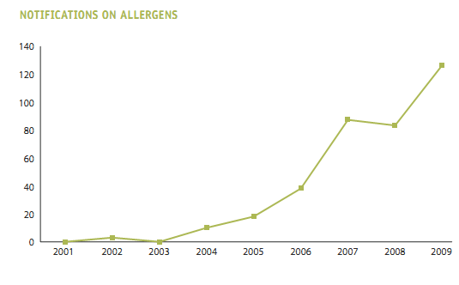
Notes:
Large increase due to undeclared milk ingredients mainly in dark chocolate and mainly from Austria. One can only assume they had a specific sampling programme or some in the inspection service has a particular penchant for dark chocolate!
There were 9 incidences of undeclared sulphites in crustacea and one of egg in a fish based product

Slide 13
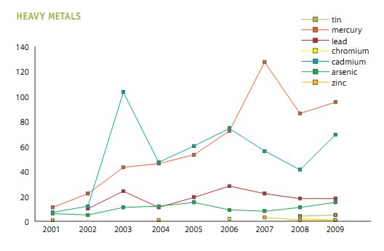
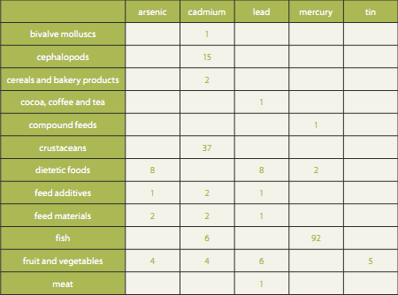
Notes:
As you can see the major problems in seafood were cadmium and mercury. The cadmium was mainly in crab and squid, whereas the mercury was mainly in fish.
The cadmium was mainly found in brown crab meat in Italy and has highlighted the different interpretation of the EU legislation among member states and work is on-going to resolve this issue.
Mercury in seafood is a different issue about which there is not much we can do except to continue to educate the public that it is not a serious problem.

Slide 14
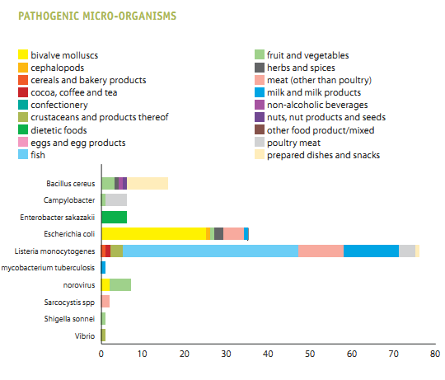
Notes:
Large increase in reporting of listeria - mainly due to detection in smoked salmon by Italy. But as the levels were below 100CFU per gram they were classified as Information alerts.

Slide 15
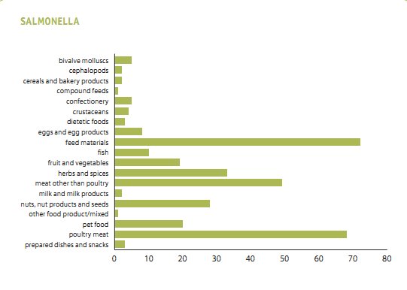
Notes:
Not a huge problem in seafood, main problem in feed material and of course poultry. Whereas a few years ago we would have seen huge problems in seafood and specifically in farmed shrimp.

Slide 16
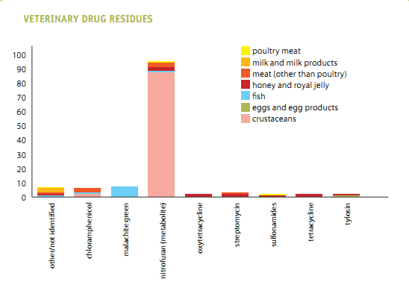
Notes:
Notifications for pesticides was consistent with 2008 173 compared to 178 the previous year but none in relation to seafood, however, the same cannot be said of veterinary drug residues. We are still experiencing particular problems with nitrofurans in crustacea. Other residues are on the decrease. Chloramphenicol was a big problem a few years ago but has declined to almost nothing. Still a bit of a problem with malachite green but again drastically reduced.

Slide 17
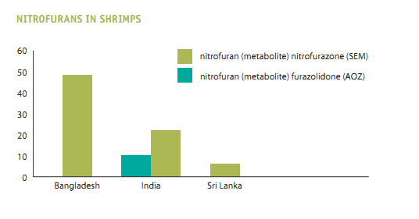
Notes:
This chart shows the specific problem with nitrofurans. At present all consignments from Bangladesh and India must be analysed at origin for nitrofurans and all consignments from Indonesia are sampled at point of entry into the EU and cleared on a positive release basis. You will hear more about this particular issue from Olivier Hotlett in his presentation later on in the conference.

Slide 18
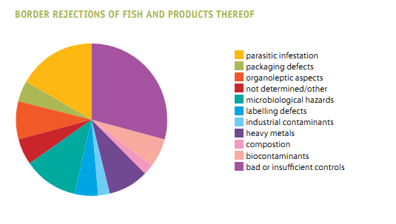
Notes:
Huge increase in notifications on seafood due to poor hygiene and poor temperature control. This is due to problems now being notified though to the RASFF network through TRACES.

Slide 19
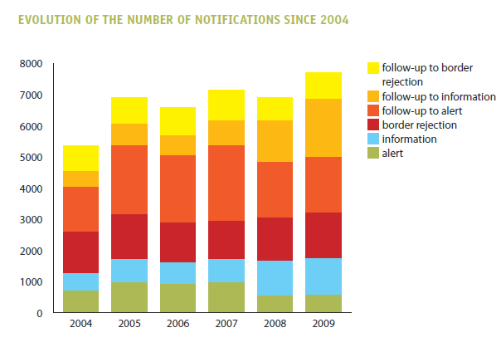

Slide 22
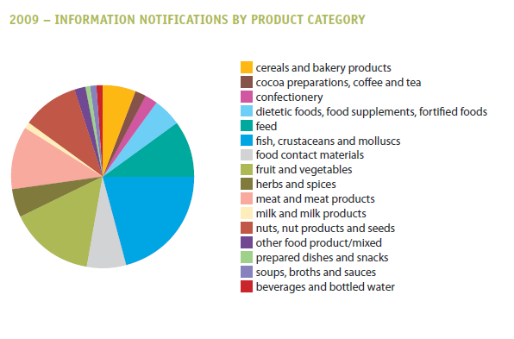

Slide 24
Notifcations by Hazard Category
Hazard | Total across all categories | Bivalves | Cephalopods | Crustacea | Fish
Potential Microbiological | 471 | 31 | 2 | 8 | 54
Insufficient controls | 145 |  | 13 | 12 | 74
Bio-contaminants | 59 |  |  |  | 50
Heavy metals | 255 | 1 | 15 | 37 | 96
Parasites | 77 |  |  |  | 69
V.Residues | 122 |  |  | 88 | 8
Total in all 24 categories including those listed | 3724 | 54 | 39 | 177 | 467
Notes:
Nuts and nut products represented the biggest number of individual notifications, followed by fish and then fruit and veg.

Slide 25
Overall Notifications comparing 2008 with 2009

